Slide 1
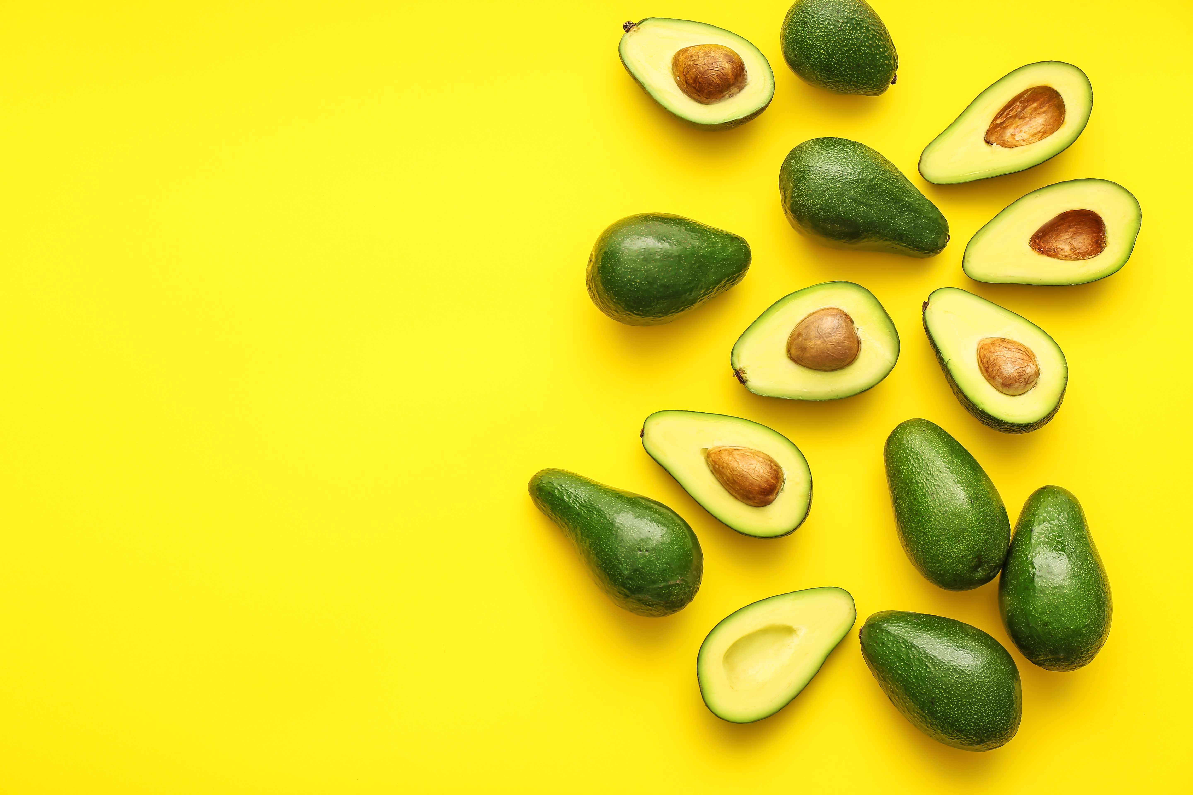
AVOCADO MADNESS
Ben Bastedo
Lourdes Rodriguez Milano
Bart Harris

Slide 2
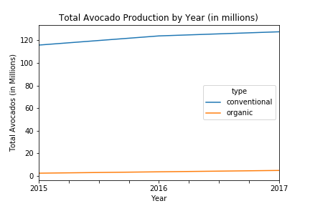
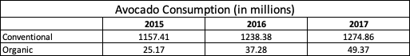
Avocado Consumption: Conventional vs. Organic

Slide 3
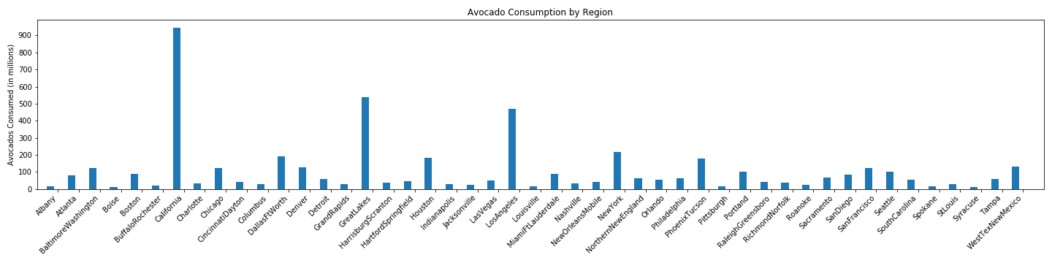
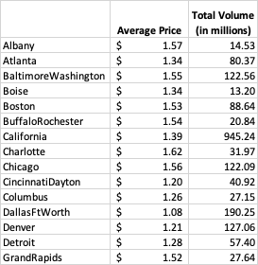
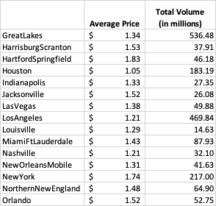
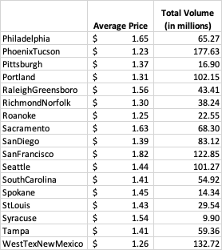
Avocado Prices and Volume by Region

Slide 4

AVOCADO PRICES BY REGION

Slide 5
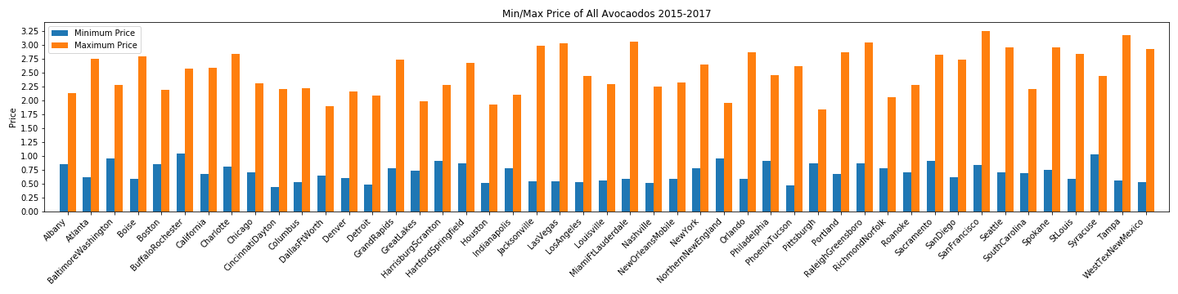
Avocado Prices by Region

Slide 6
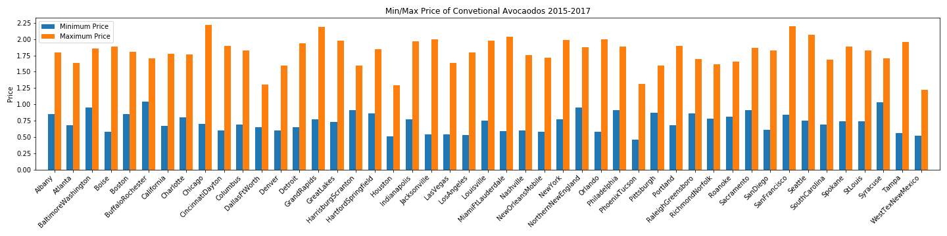
Avocado Prices by Region cont.

Slide 7
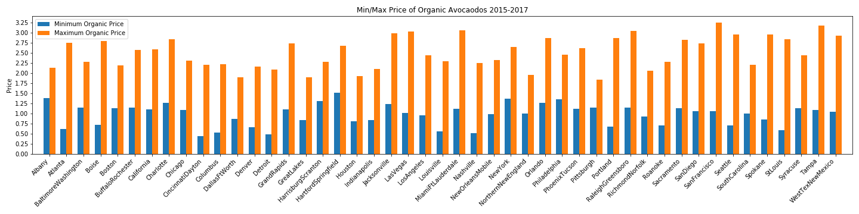
Avocado Prices by Region cont.

Slide 8
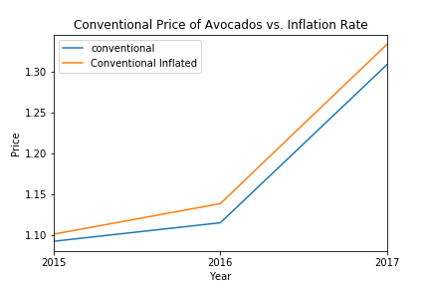
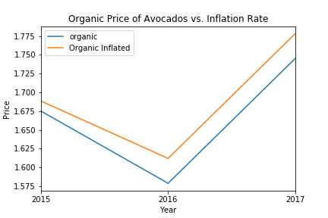
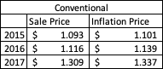
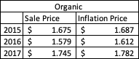
Avocado Price vs. National Inflation

Slide 10

TOTAL AVOCADO VOLUME VS. INCOME PER CAPITA

Slide 11
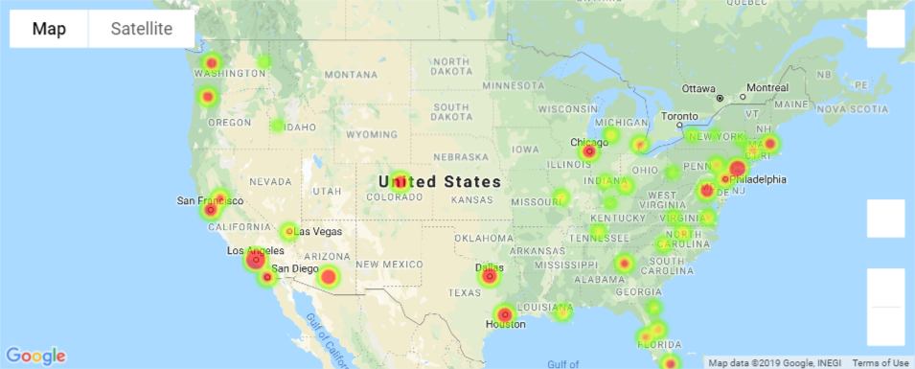
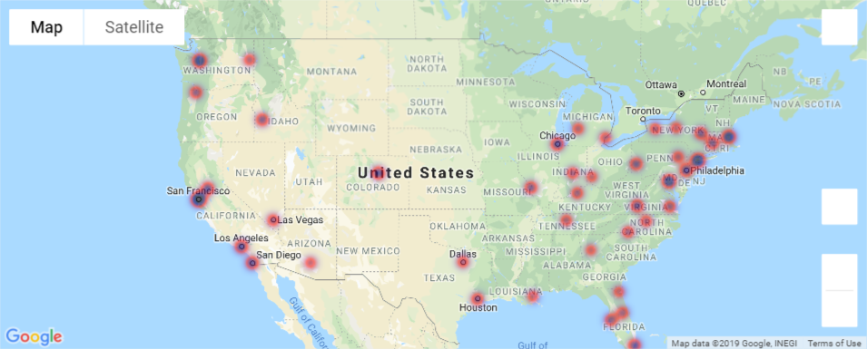
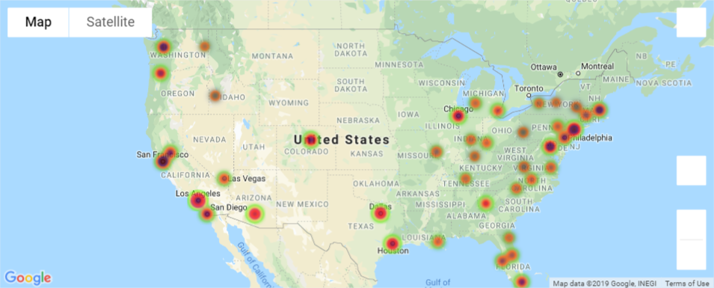
Total Volume 2015
Per Capita Income 2015
Total Volumes and Per Capita Income 2015

Slide 12
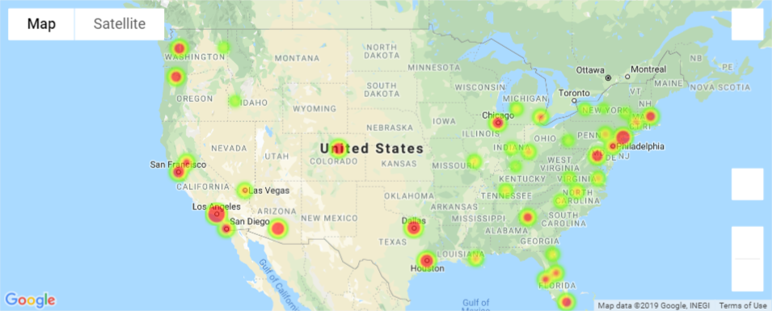
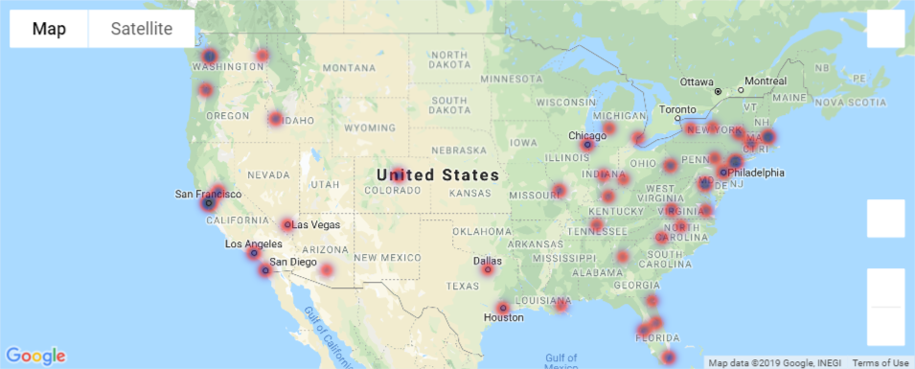
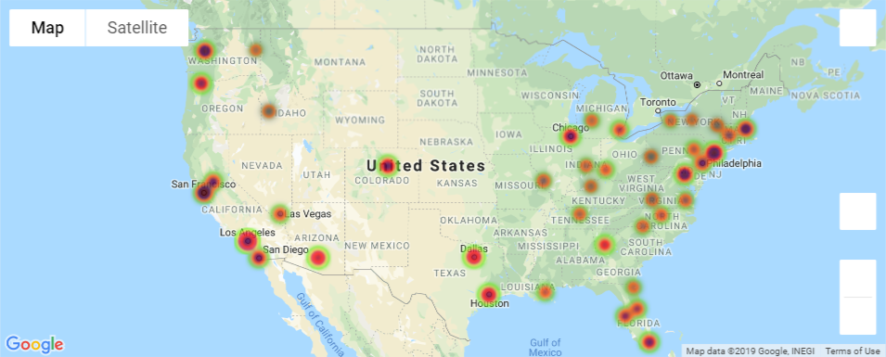
Total Volume 2016
Per Capita Income 2016
Total Volumes and Per Capita Income 2016

Slide 13
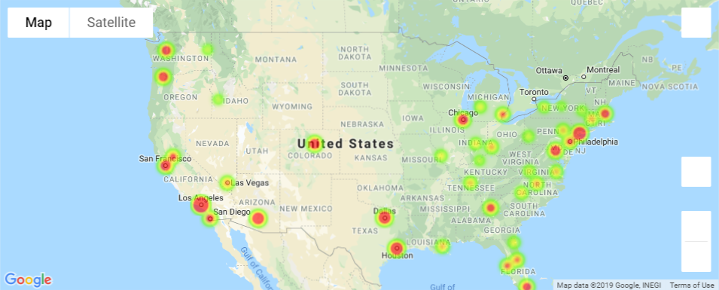
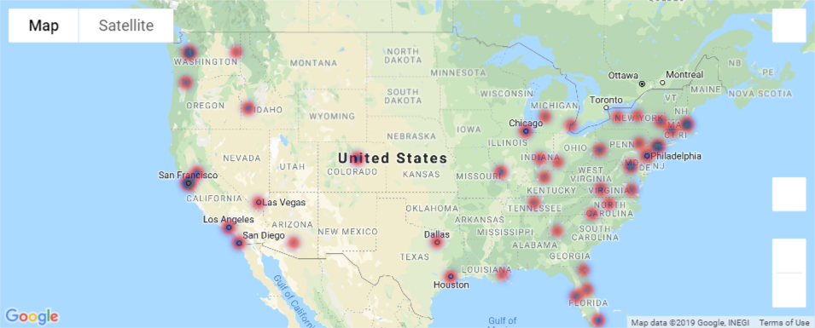
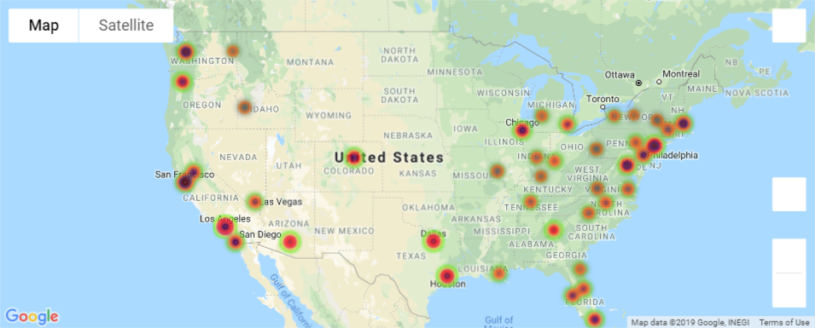
Total Volume 2017
Per Capita Income 2017
Total Volumes and Per Capita Income 2017

Slide 14
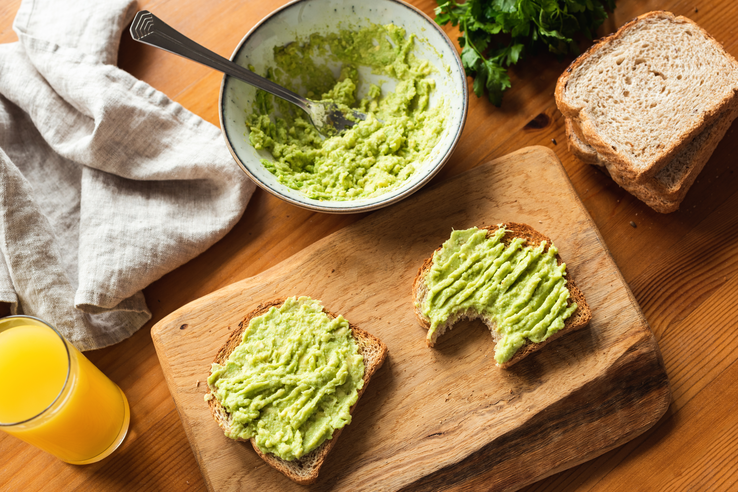
SUMMARY

Slide 15
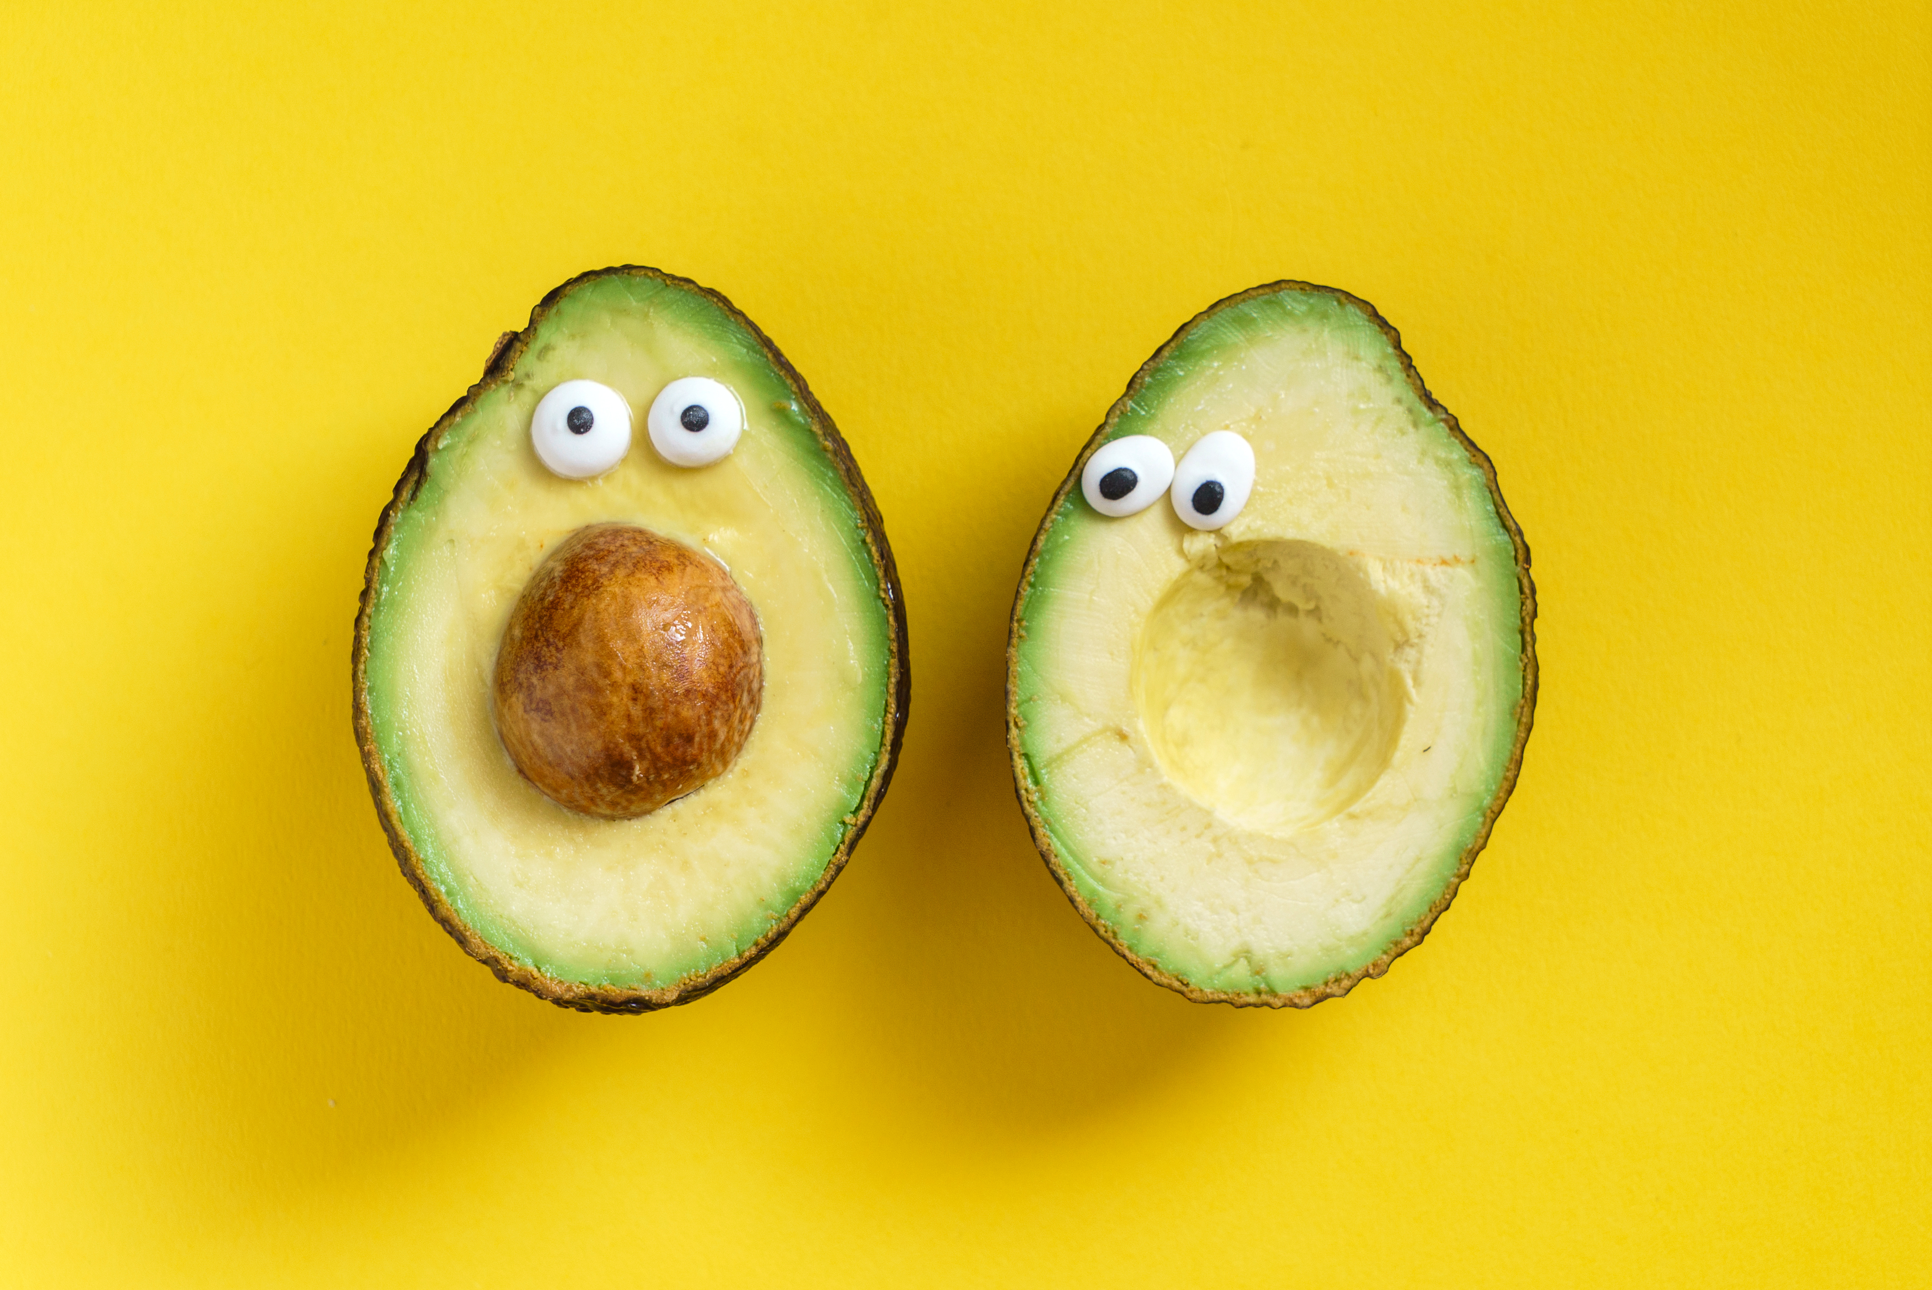
WHAT’S NEXT??

